Slide 1
Machine Vision II presentation
By Anand Low Hong Ren

Slide 2
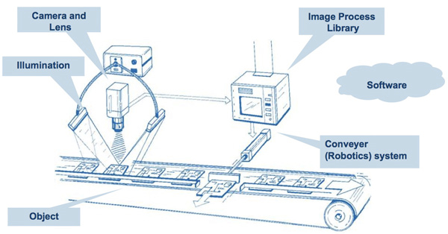
Machine Vision- An Introduction
a combination of hardware and software provides functional guidance to machines in the execution of their tasks by collecting information from image capturing and processing

Slide 3
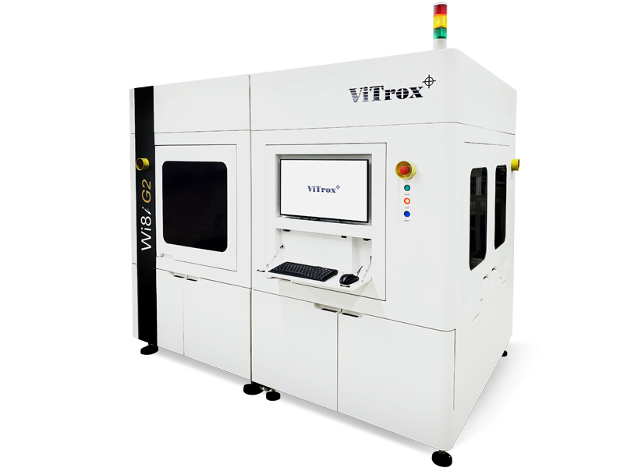
Machine vision application in Vitrox
2D Surface Inspection
3D Vision Inspection
3D X-RAY inspection

Slide 4
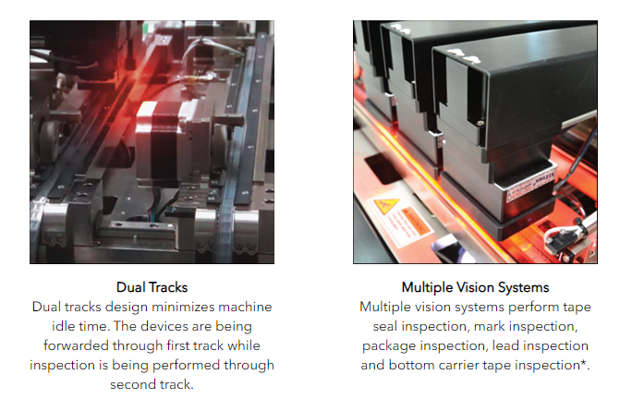
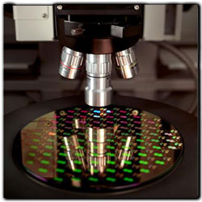
2D surface inspection
Wafer Vision Inspection
Post Seal/Tray-based Inspection

Slide 5
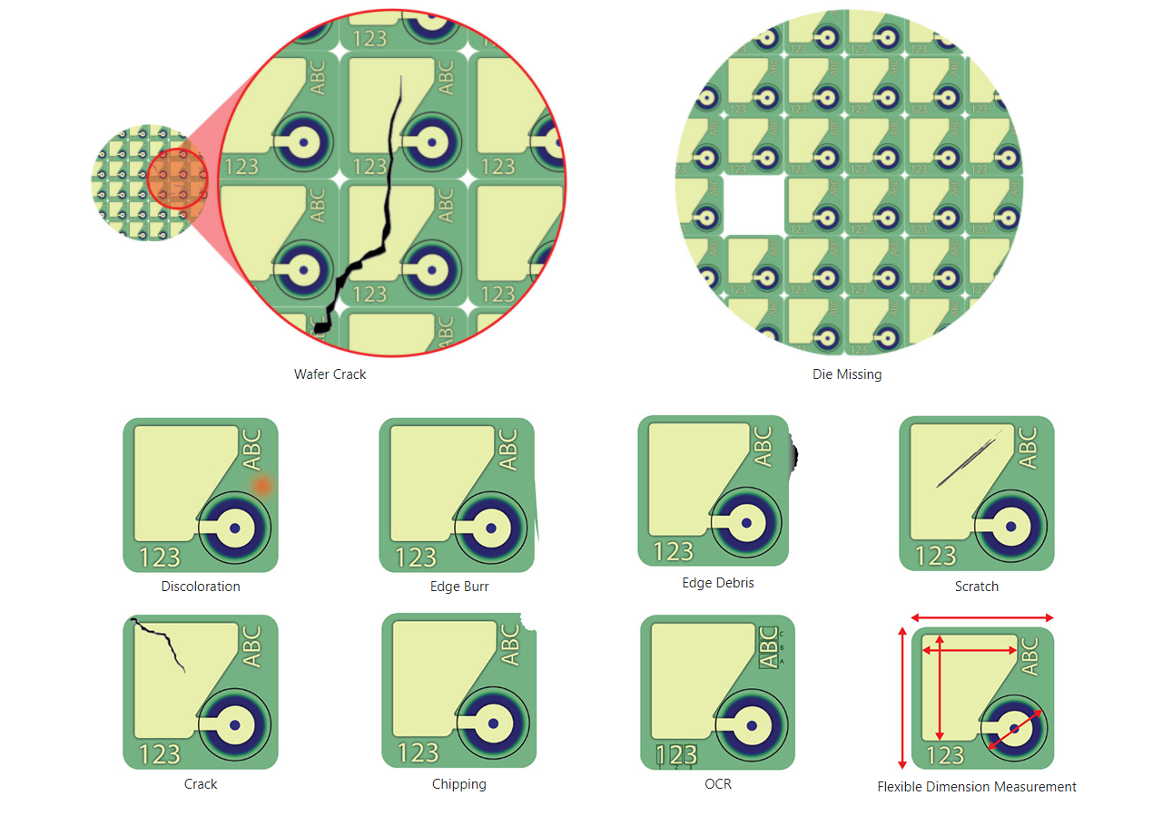
Wafer Inspection
measurements, 2D sample surface defect inspections
Supports raw wafer, hoop rings and framed wafers
Notes:
top/ bottom inspection
Raw wafer,

Slide 6
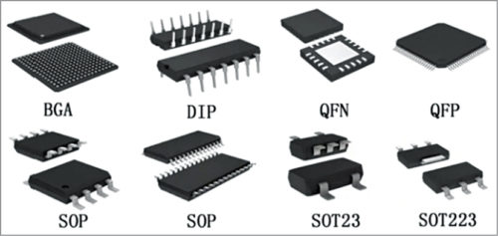
IC packages Inspection
Inspection for different type of IC packages
Post Seal- Inspect IC packages in tape
Tray-based- Inspect multiple IC packages in a tray
Able to inspect tape, marking and IC package defect

Slide 7
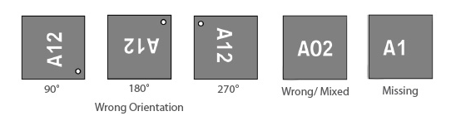
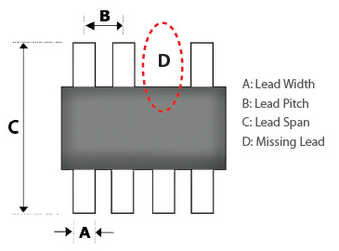
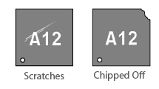
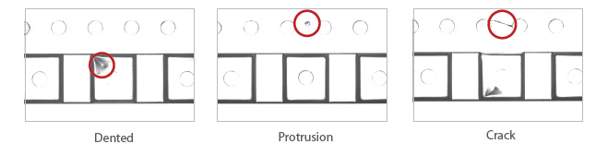
Defects

Slide 8
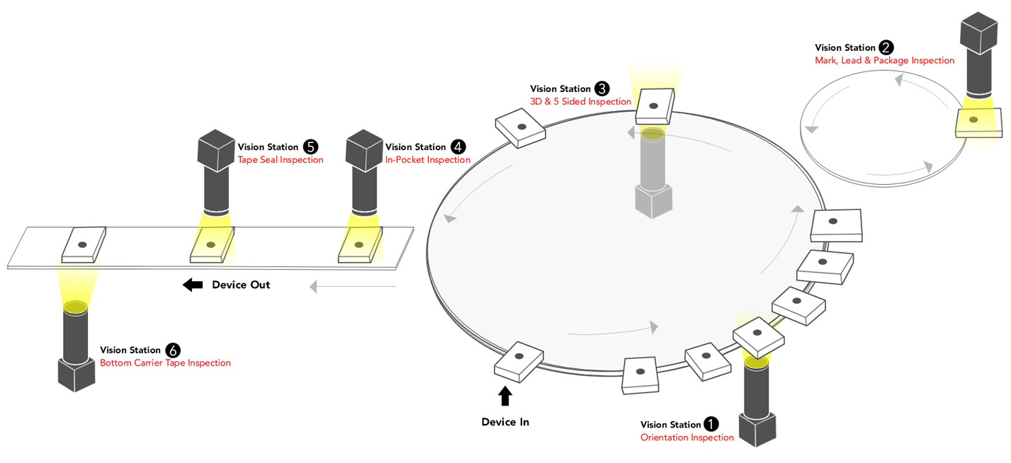
Vision Inspection System used
Vision Inspection System for tape or to-reel models

Slide 9
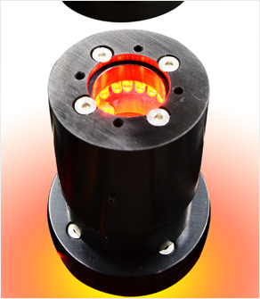
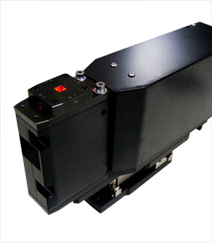
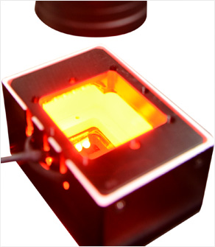
Inspect mark, lead and package
Inspect 5 sides of IC package
Inspect tape seal

Slide 10
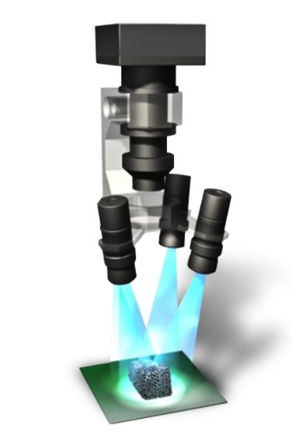
3D vision inspection
paste inspection on different kinds of PCBs
analyzing the area and height of the solder paste, then builds a 3D image of the solder paste
RGB lighting from different angles which helps to filter solder paste, scaling powder and other impurities.

Slide 11
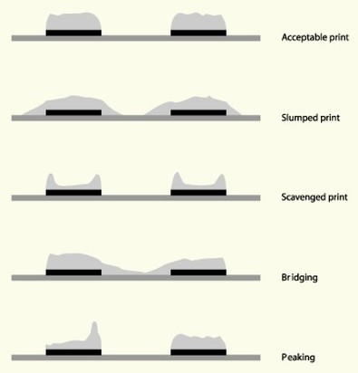
Paste defects

Slide 12
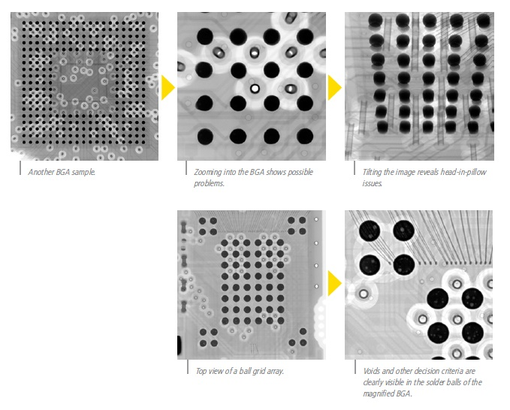
3D x-ray inspection
Inspect different sizes of PCB assembly at micron level with maximum throughput
Measurement and defect inspection
The speed of these models is around 500 to 1000 images per minute

Slide 13
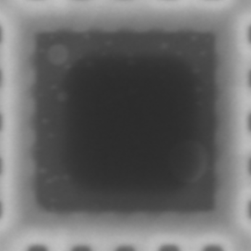
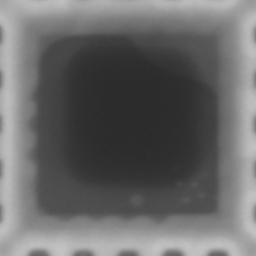
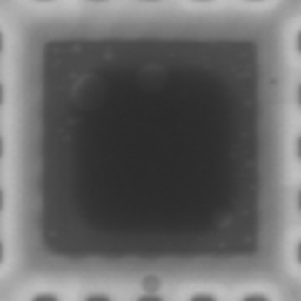
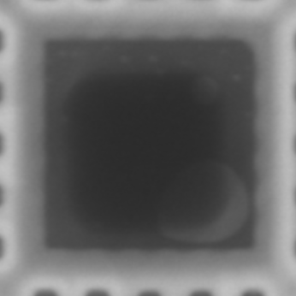
Image Void Detection
Aim: Detect the voids in the image
Solder voids are created when gasses released from solder paste are trapped into the solder joint.
Disadvantages of voids:
Weakness, cracks in solder joint
Failure in transferring heat away from component

Slide 14
Problem: The image contrast not good
Solution: Increase or enhance through different methods:
CLAHE (Contrast Limited Adaptive Histogram Equalization)
Histogram Equalization
PIL library increase contrast
After applying these method I will use binary thresholding to show how well it can segment the void from the background.

Slide 15
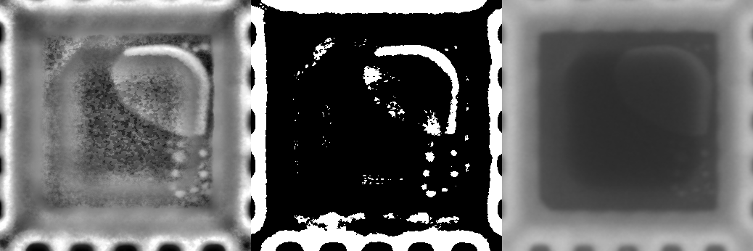
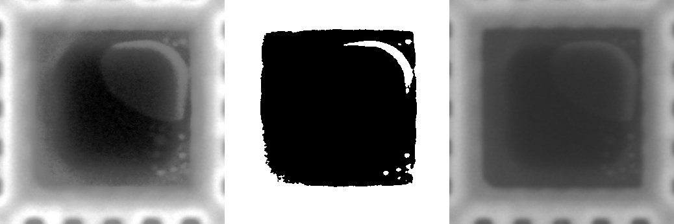
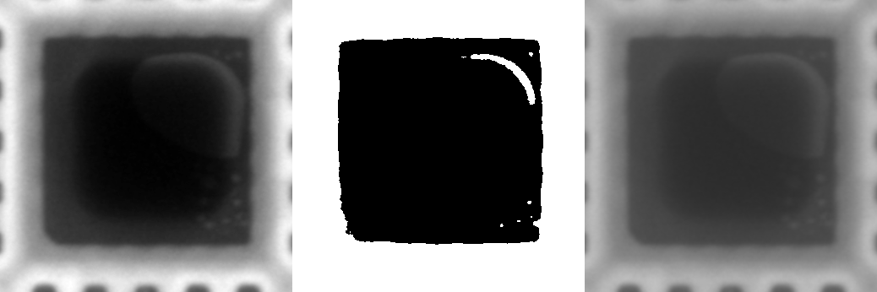
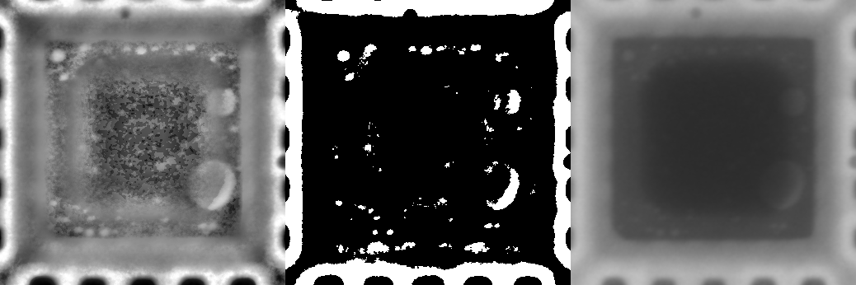
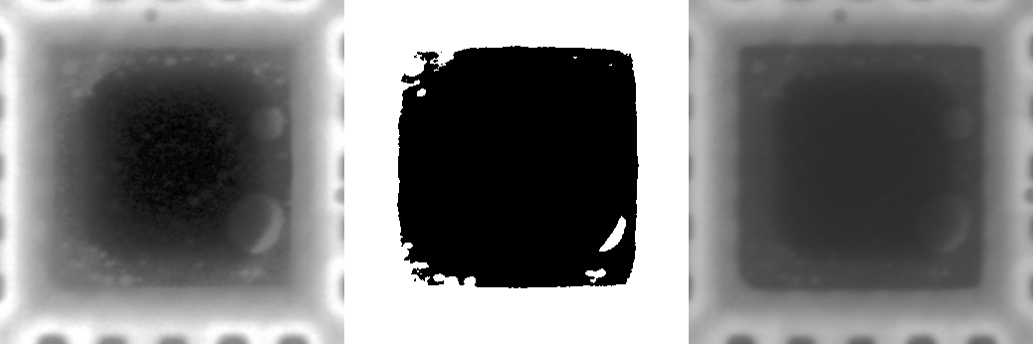
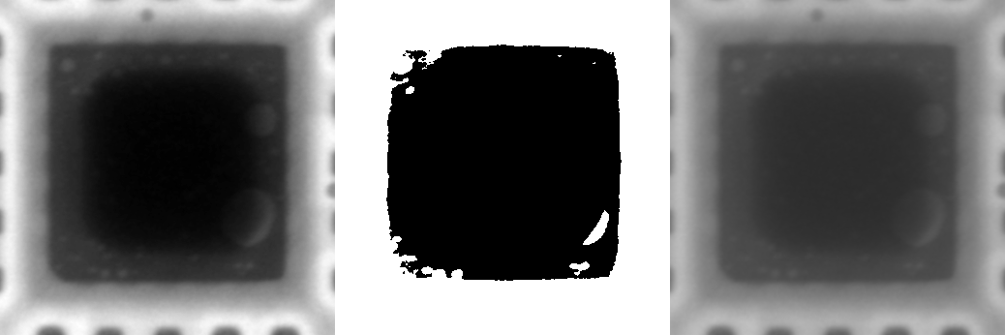
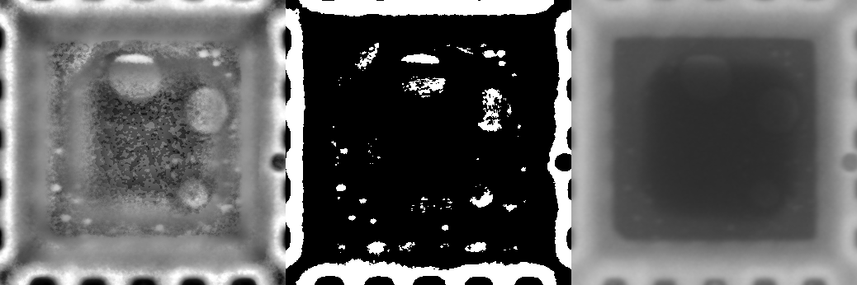
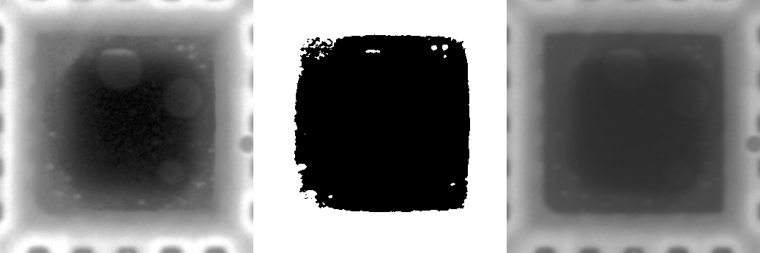
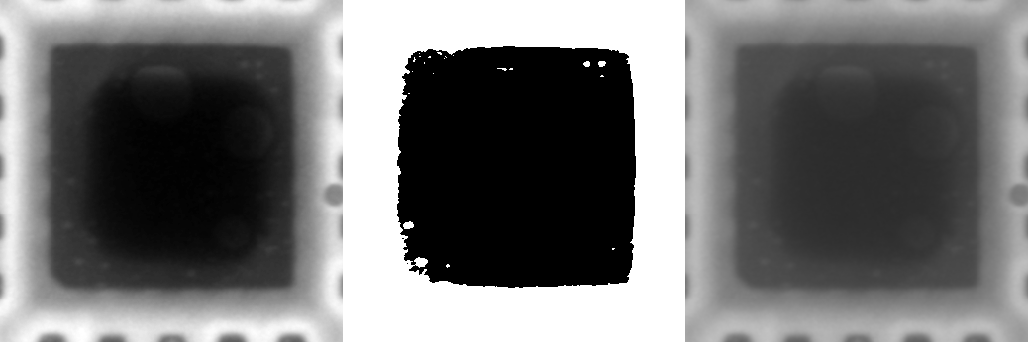
Histogram Equalization
Original
CLAHE
PIL increase contrast
Notes:
CLAHE: Contrast Limited Adaptive Histogram Equalization
Most voids are able to be segmented
Voids that cover dark and light part segmented partially
Histogram Equalization: Some voids can be detected, some cannot
Contrast also got enhance
PIL: contrast got increase but the void is not as visible as other methods
Thresholding almost same as histogram equalisation

Slide 16
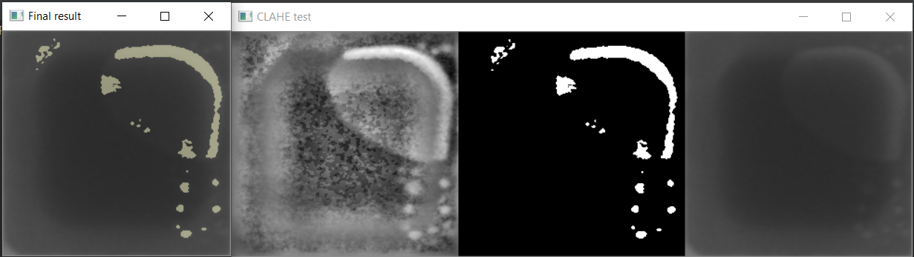
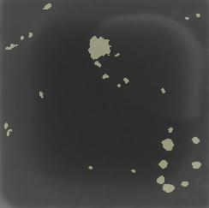

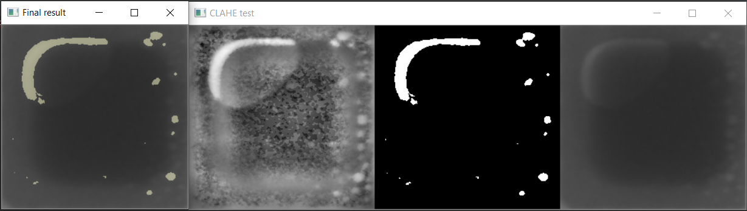
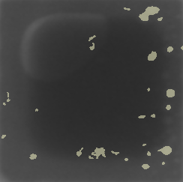
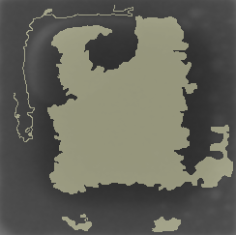
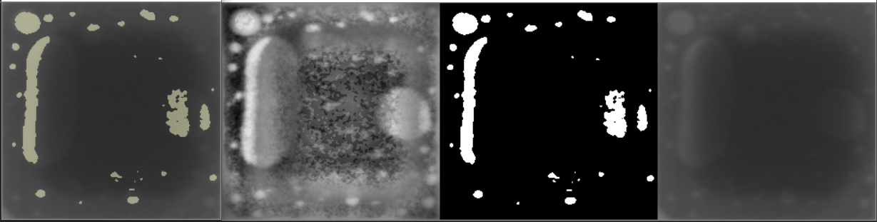
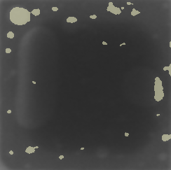
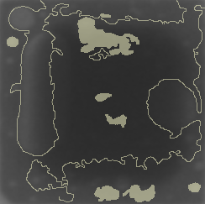
Void detection
CLAHE + binary threshold (110) + canny edge detector
CLAHE + binary threshold (140) filter with area and circularity
CLAHE + binary threshold (157)
Original
Notes:
CLAHE + binary threshold (157)
CLAHE + binary threshold (140) filter with area and circularity
Area limited to between 5 and 1000 px^2
Circularity is limited between 0.3 and 1.2
More voids detected but more false positives

Slide 17
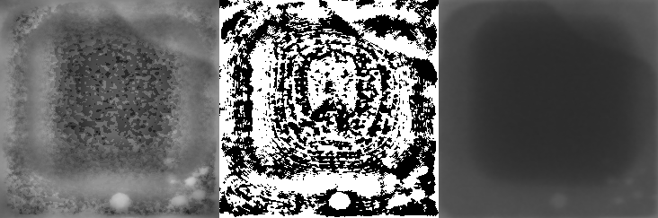
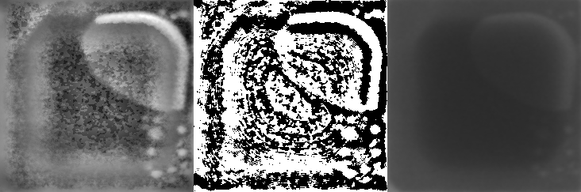
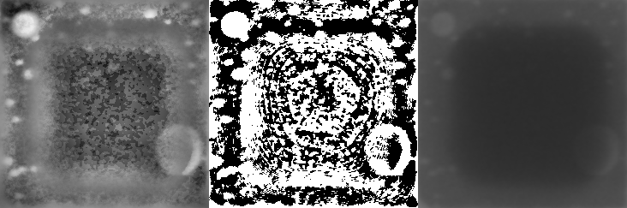
CLAHE + adaptive gaussian thresholding (blockSize 5)
block size, which determines the block size of the kernel used by the algorithm to apply local thresholding.
A lot of noise is also segmented
Not that great

Slide 18
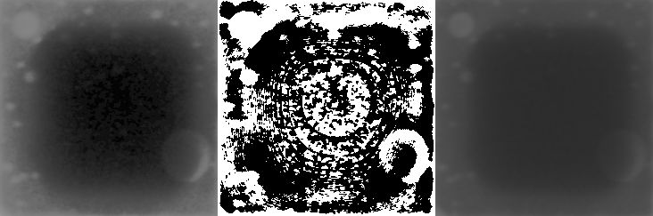
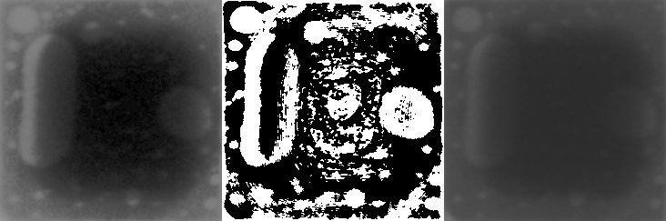
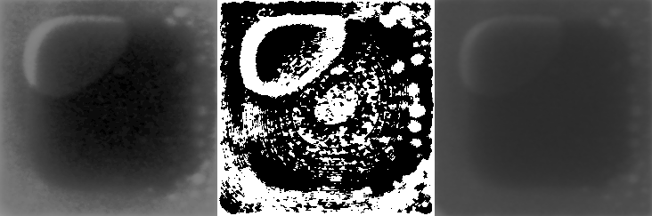
Histogram Equalization + adaptive gaussian thresholding (blockSize 101)
Better segmentation of the voids
Some noise is segmented
Can be used to detect uneven lighting voids

Slide 19
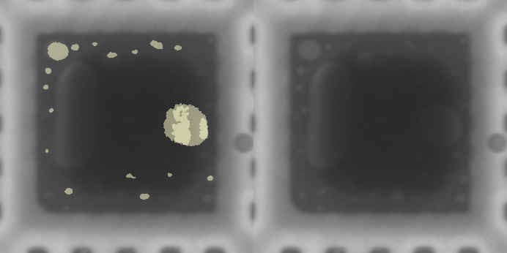
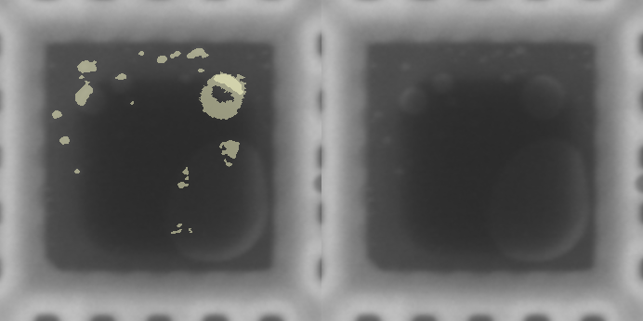
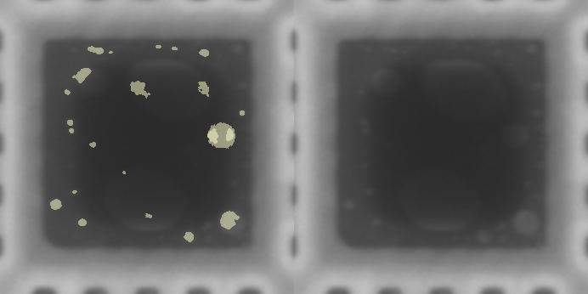
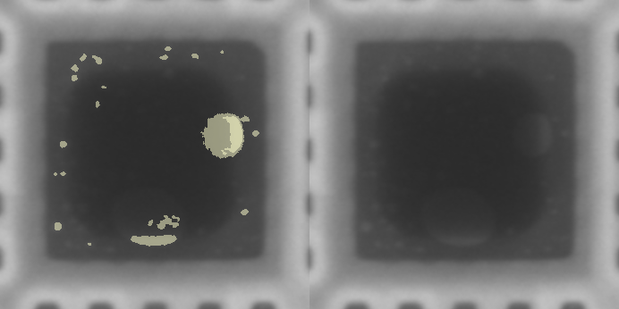
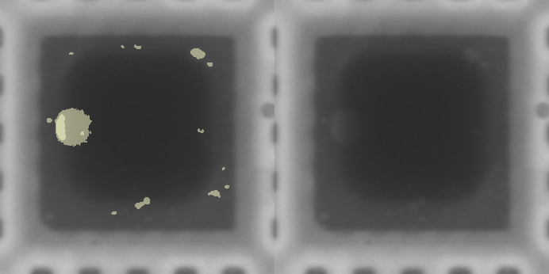
CLAHE binary thresholding of 157 + Histogram Equalization adaptive thresholding (blockSize 101)

Slide 20
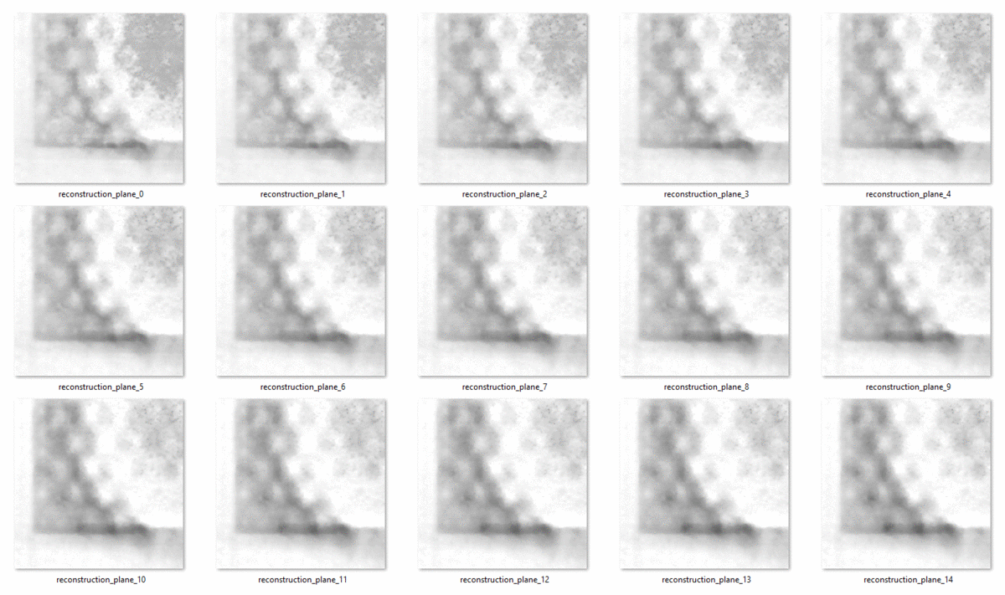
Machine Learning
Aim: implement machine learning into determining the image quality of a x-ray BGA scan
BGA scan:

Slide 21

Cropped BGA scan

Slide 22

Reconstructed BGA slice
Delta T
Step weight
3 parameters affect the quality of BGA scan:
Stepweight (6)
Delta T (7)
Scan Speed (3)
42 images * 3 scan speed = 126 different images with different qualities
2 regions: 126 * 2 = 252

Slide 23







Quality of BGA scan
Noisy
Sun
Popcorn
Nothing
Ring
Good
Nothing

Slide 24
Calculate RMSE, MI and SSIM
With Delta T, stepweight and scan speed, we do not have enough information to determine whether the BGA scan quality
Therefore, we have to calculate other variables to improve the prediction for our machine learning model
These 3 variables find the difference between 2 images.
The idea is to take the best image in the 42 images as the reference image, then compare all the 42 images to it to get RMSE ( Root mean square error), MI( mutual information) and SSIM (structural similarity index measure).
Notes:
Root mean square - Higher means more difference between test and reference image ( if image is the same object but slightly displaced, there will also be root mean square error even though it is the same image

Slide 25
Brief introduction to RMSE, MI and SSIM
Root mean square error
measures the amount of change per pixel
Higher means more difference between test and reference image
Not robust
Mutual Information
Uses probability to guess the mutual pixels in images
calculated on a pixel by pixel basis ( Not robust)
Higher MI higher similarity between two images
Structural Similarity Index Measure
Structural information is pixels that have strong inter-dependencies especially when they are spatially close.
More like Human Vision System
Have a range between 0 - 1, the higher the more similar two images are.

Slide 26

Delta T
Step weight
Reference Image

Slide 27
Some examples of the data collected
stepweight | Delta T | speed | RMSE | MI | SSIM | condition
0.1 | 4.84E-08 | s1 | 1.29E-06 | 0.756178275 | 0.632789524 | ring
0.1 | 4.84E-09 | s1 | 5.49E-07 | 2.146384532 | 0.955476754 | good
0.4 | 4.84E-09 | s1 | 6.20E-07 | 1.633553416 | 0.914007385 | popcorn
0.1 | 8.80E-07 | s1 | 2.88E-06 | 0.279332839 | 0.024740113 | noisy
0.1 | 8.80E-08 | s1 | 1.01E-06 | 0.95342639 | 0.460349767 | sun

Slide 28

Data Visualisation - Boxplot
RMSE: the minimum value is 2e-9 while maximum value is 3.06e-6 with the median being 1.135e-06
MI: outlier at around 5, which is the MI of a perfectly similar image. The rest are distributed around the range of 0.28 to 2.36 with the median being 0.95
SSIM: maximum value is 1 which is perfectly similar, and the minimum value is 0.015 with the median being 0.601
Notes:
Say how i prepare my data like I label my data then what i should expect from my machine learning algorithm

Slide 29

Data Visualisation - Histogram
Notes:
Shows distribution of the data

Slide 30

Data Visualisation- Scatter Matrix
Notes:
-diagonal grouping of some pairs of attributes. This suggests a high correlation and a predictable relationship. From below we can see that RMSE, MI and SSIM have high correlation between each other

Slide 31
Spotcheck machine learning algorithms
K-fold Cross Validation
The dataset is shuffled randomly
Split the dataset into k groups
For each unique group:
Take the group as test data set
Take the remaining groups as training data set
Fit a model on the training set and evaluate the test data set
Retain the evaluation score
Display the skill of the model using average accuracy or other metrics
Repeat for 6 models ( logistic regression, linear discriminant analysis, K- Nearest Neighbor Classifier, Decision Tree Classifier, and Gaussian Naive Bayes).
Better accuracy better algorithm

Slide 32
Accuracy of each algorithm (k-fold cross validation)
Dataset | Logistic Regression | Linear Discriminant Analysis | K Nearest Neighbor | Decision Tree | Gaussian Naive Bayes | SVM
RRID30 S1 | 0.75000 | 0.93333 | 0.75000 | 0.96667 | 0.93333 | 0.77500
RRID30 S3 | 0.71667 | 1.00000 | 0.86667 | 1.00000 | 0.97500 | 0.89167
RRID30 S5 | 0.74167 | 0.96667 | 0.83333 | 0.96667 | 0.94167 | 0.85833
RRID69 S1 | 0.80833 | 0.92500 | 0.85833 | 0.92500 | 0.95000 | 0.83333
RRID69 S3 | 0.81667 | 0.94167 | 0.88333 | 0.94167 | 0.97500 | 0.91667
RRID69 S5 | 0.77500 | 0.94167 | 0.85000 | 1.00000 | 0.89167 | 0.86667
RRID30 compiled | 0.76000 | 0.97000 | 0.87000 | 0.94000 | 0.96000 | 0.92000
RRID69 compiled | 0.69000 | 0.91000 | 0.87000 | 0.86000 | 0.89000 | 0.84000
Notes:
decision tree classifier, linear discriminant analysis and Gaussian naive bayes produce the best results among the six algorithms, thus we will use these 3 algorithms to build our machine learning model.

Slide 33


Linear Discriminant Analysis
reduction method for dimensionality
Minimise no. of dimensions while preserving as much details as possible
For example, imagine that we have plotted the relationship between two variables in which a particular class is represented by each colour
reduce the number of dimensions down to 1
Not so good because info provided by X2 is lost

Slide 34


Linear Discriminant Analysis Pt. 2
Notes:
Linear Discriminant Analysis, or LDA, uses the data from both features to construct a new axis and projects the information to the new axis in such a manner that the variation is reduced and the distance between the means of the two groups is maximised

Slide 35

Decision Tree
data is continuously split according to a certain parameter
Decision tree consists of:
Nodes: Test for the value of a certain feature.
Edges/Branch: Results from the outcome of a test and connect to the the next node or leaf
Leaf nodes: Terminal nodes that predict the outcome (at the end of the decision tree)

Slide 36

Gaussian Naive Bayes
based on the Bayes Theorem
strong independence or no relationship between features/ variables
Assumption: the continuous values of each class are distributed according to a Gaussian distribution
Notes:
-naive bayes why naive
-

Slide 37
Train data with linear discriminant analysis, decision tree and Gaussian Naive Bayes
Each dataset is split into two sets:
80% - Training dataset
20% - Test dataset
The training dataset is used to train the machine learning algorithm
Then, the test dataset is to test the trained machine learning model
The accuracy of training and dataset are recorded.

Slide 38
Accuracy of Training Data
Training Dataset | Linear Discriminant Analysis | Decision Tree | Gaussian Naive Bayes
RRID30 S1 | 0.939394 | 1.000000 | 0.969697
RRID30 S3 | 1.00000 | 1.00000 | 1.000000
RRID30 S5 | 1.000000 | 1.000000 | 0.969697
RRID69 S1 | 1.000000 | 1.000000 | 1.000000
RRID69 S3 | 1.000000 | 1.000000 | 1.000000
RRID69 S5 | 0.969697 | 1.000000 | 1.000000
RRID30 compiled | 0.970000 | 1.000000 | 0.960000
RRID69 compiled | 0.960000 | 1.000000 | 0.940000

Slide 39
Accuracy of Test Data
Test Dataset | Linear Discriminant Analysis | Decision Tree | Gaussian Naive Bayes
RRID30 S1 | 0.777778 | 1.000000 | 1.000000
RRID30 S3 | 1.00000 | 1.00000 | 1.000000
RRID30 S5 | 0.888889 | 0.888889 | 0.888889
RRID69 S1 | 0.888889 | 0.666667 | 0.555556
RRID69 S3 | 0.888889 | 0.555556 | 0.555556
RRID69 S5 | 0.777778 | 0.777778 | 0.666667
RRID30 compiled | 1.000000 | 0.961538 | 1.000000
RRID69 compiled | 0.961538 | 1.000000 | 1.000000
Average Accuracy | 0.897970 | 0.856304 | 0.833334

Slide 40

Q & A Session

Slide 41
The End

